Slide 1
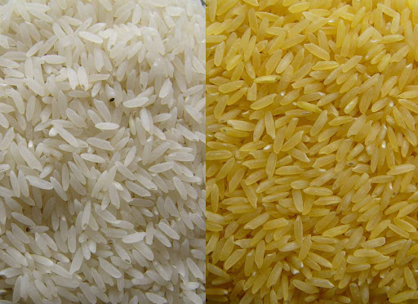

Presentation and discussion of the paper:
Engineering the Provitamin A (B-Carotene) Biosynthetic Pathway into (Carotenoid-Free) Rice Endosperm
By: Hasan Alhaddad
Research Topics & Seminar (501)
x/x/xxxx

Slide 2
Outline
Reference of the paper

Slide 3

The paper

Slide 4
Rice (Oryza sativa)
Reference of the paper

Slide 5
Idea/problem
Reference of the paper

Slide 6
Methods 1: transformation via agrobacterium

Slide 7
Method 2:
Reference of the paper

Slide 8
Results
Reference of the paper

Slide 9
Outline
Reference of the paper

Slide 10
Outline
Reference of the paper

Slide 11
Outline
Reference of the paper

